Slide 1
Microsoft Reading and Writing Tools: Designed for Learning Differences… Inclusively Helpful Jeff Petty Principal Program Manager Mari Broman Olsen Senior Program Manager

Slide 2

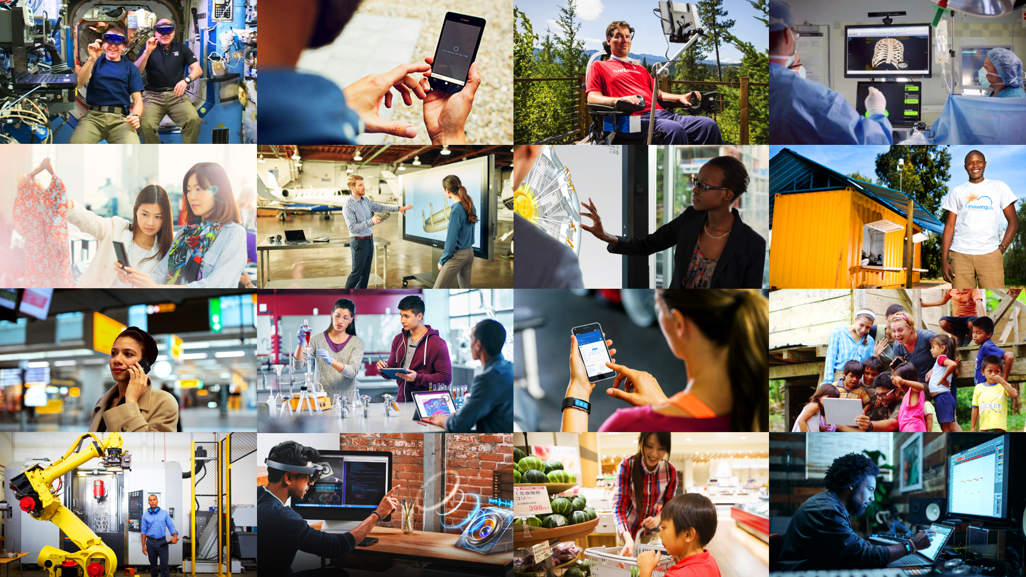
Microsoft Mission
Microsoft Mission
Empower every person and every organization on the planet to achieve more

Slide 3

Meet Sophia
4th grade
Difficulty with organizing, reading and writing
Person with dyslexia
Has Individual Education Plan (IEP)
Represents a significant student population

Slide 4
Modern Classrooms are Diverse*
99% of teachers have students in their classrooms who need assistance/intervention for social, emotional, or behavioral reasons.​
73% of teachers report working in classrooms with student reading levels that span four or more grade levels.​
72% of classrooms have special education students.​
52% of teachers in the United States have English language learners in their classroom.
*Scholastic.com

Slide 5

Our Goal: Better Learning Environments
Empower students to do their best work
Enable teachers to engage every learner
Ensure equity and inclusion in schools

Slide 6
Help Students Do Their Best Work
Organize
Read better
Write better

Slide 7
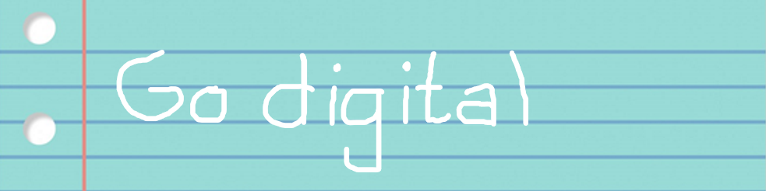
Go digital

Slide 8

Free Office Lens on iOS with Immersive Reader http://aka.ms/officelens

Slide 9
Free Learning Tools for OneNote http://onenote.com/learningtools

Slide 10
Read better
Reabdetter

Slide 11
Demonstrations
Learning Tools for OneNote
Learning Tools in Edge

Slide 12
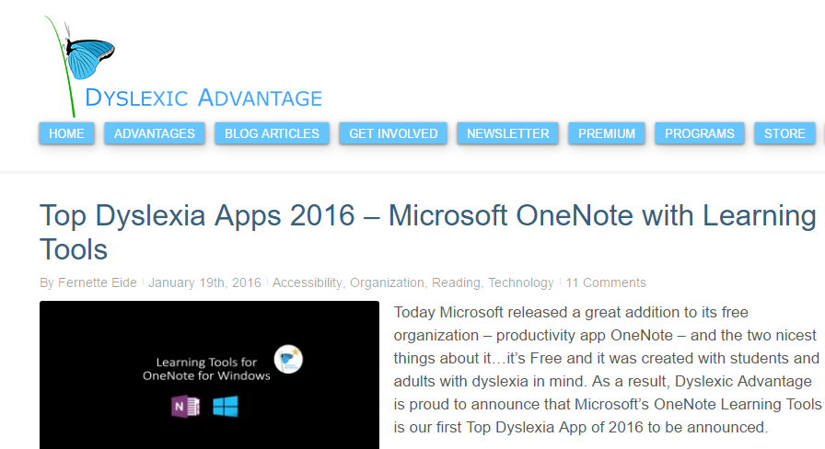
Developed with Experts, e.g. Drs. Brock and Fernette Eide, Dyslexic Advantage

Slide 13
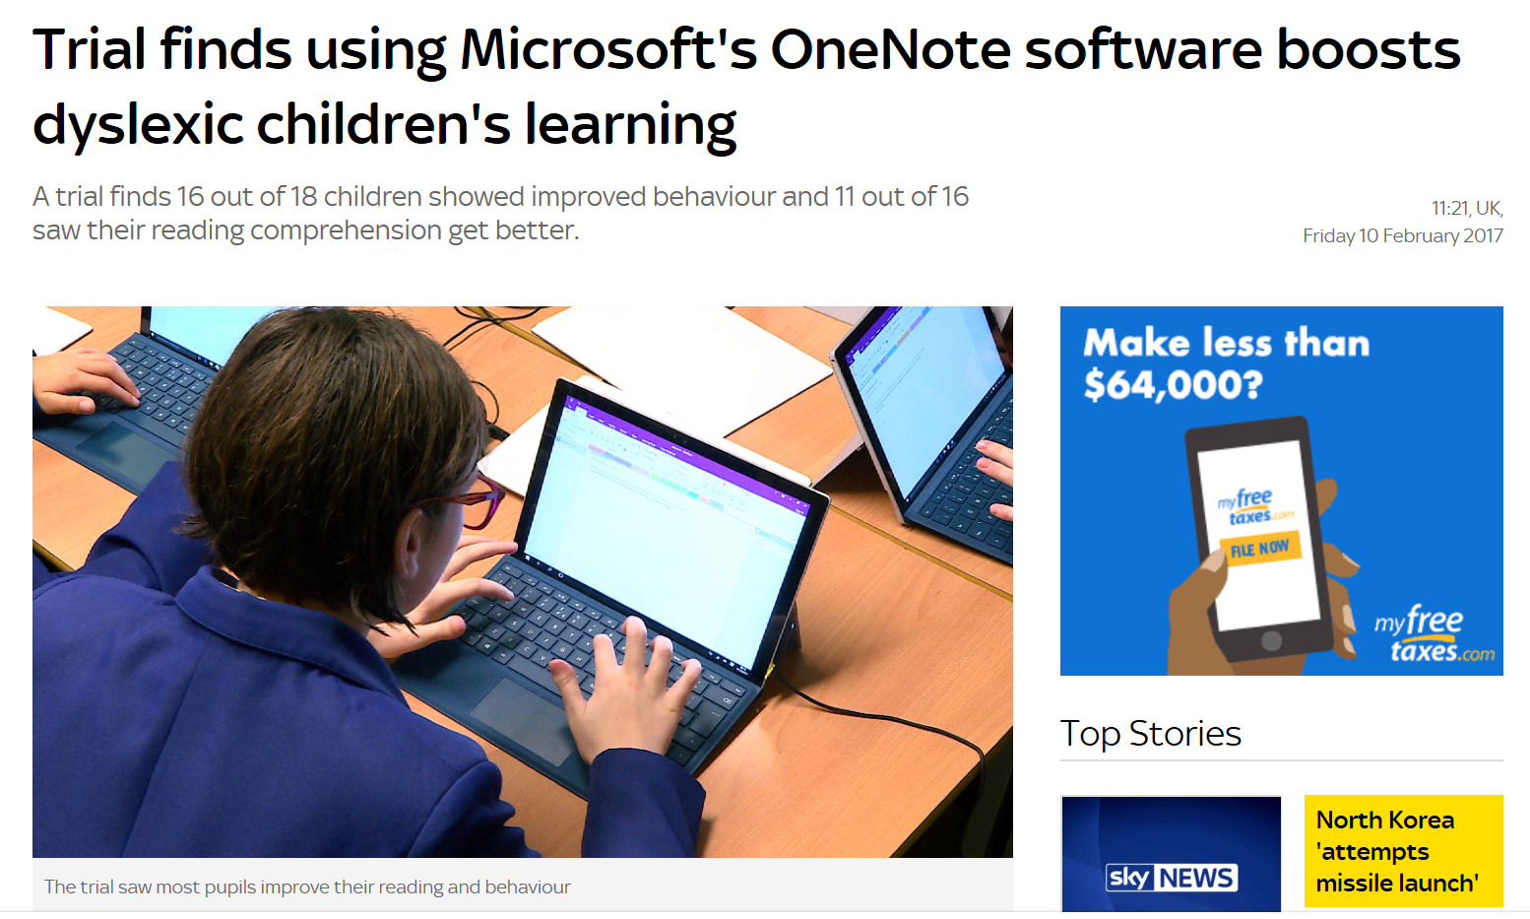
Supported by Research British Dyslexia Association & Knowl Hill School Study

Slide 14

Learning Tools 3rd party research study – RTI
4th grade, 6th-8th, and 10-12th grade students
Reading Comprehension scores improved
Writing improved
Non-cognitive processes improved
Equal access of materials
Full Report: http://aka.ms/LearningToolsStudy

Slide 15
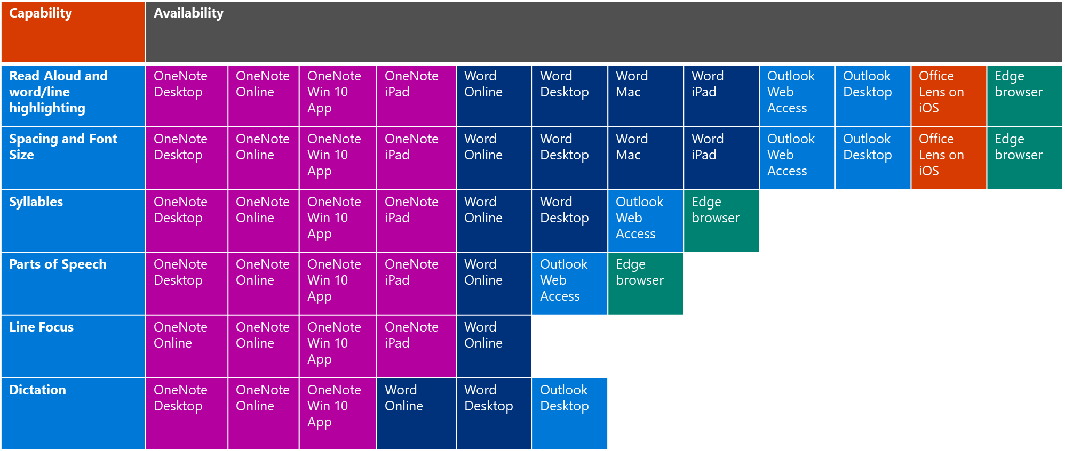
Learning Tools Availability

Slide 16
Write better
Rite mor betr

Slide 17
Editor Demonstration
Spelling tools
Overview
Learning Tools

Slide 18
Write better with …
Editor
Word Learning Tools
Dictation
Sophia can turn her thoughts into a story by … telling a story!
Built-in to Windows 10 (Fall Creators Update for English US)
Free Office plug-in: Using AI speech recognition in Word, PowerPoint, Outlook
Word prediction
When Sophia is stuck on finding that next word, Word Prediction will be there to help her get over the hump. The prediction-feedback loop also acts as a learning tool, helping Sophia become a more capable writer over time.

Slide 19
Explore (free!) how to…
Go paperless with Office Lens and OneNote
Aka.ms/OfficeLens & OneNote.com/learningtools
Get Office for free and communicate and collaborate seamlessly
Aka.ms/OfficeEducation
Become an Office Insider and give us feedback
Aka.ms/OfficeInsider

Slide 20
We want to hear from you.
Connect with us in person today or anytime through our support and feedback channels.
Disability Answer Desk for phone/chat/ASL Help: Aka.ms/AccessibilitySupport
User voice Forum for Accessibility Feedback: Aka.ms/AccessibilityFeedback

